Slide 1
CH8 Trading Design

Slide 2
Agenda
Band design for white noise
Spread Dynamics
Nonparametric Approach
Regularization
Tying Up Loose End

Slide 3
個股相關性
挑選股票
共整合測試
高流動性(50ETF)
均值恢復
交易能力測試
高頻過零率(以拔靴法取樣檢測)
殘差序列應為定態
母數方法(需模擬出樣本的母數與特性)
門檻值通道設定
無母數方法(對樣本的直接處理)
止損點設計與否

Slide 4
Band Design For White Noise
General principle:
- Deviation from equilibrium : Put on trade
- Restore : Unwind
So , how and when? It make general principle wide and varied.
This book tell us two method :
1 . Put on a spread position deviation of Δ from the equilibrium value and
liquidate the position upon mean reversion.
2 . The spread swings equally in both directions about the equilibrium value
and unwind the trade when it deviates by Δ in the opposite direction.
Why we need to do this?
Reduce the trading frequency → Reduce the Bid-Ask spread effect (slippage)

Slide 5
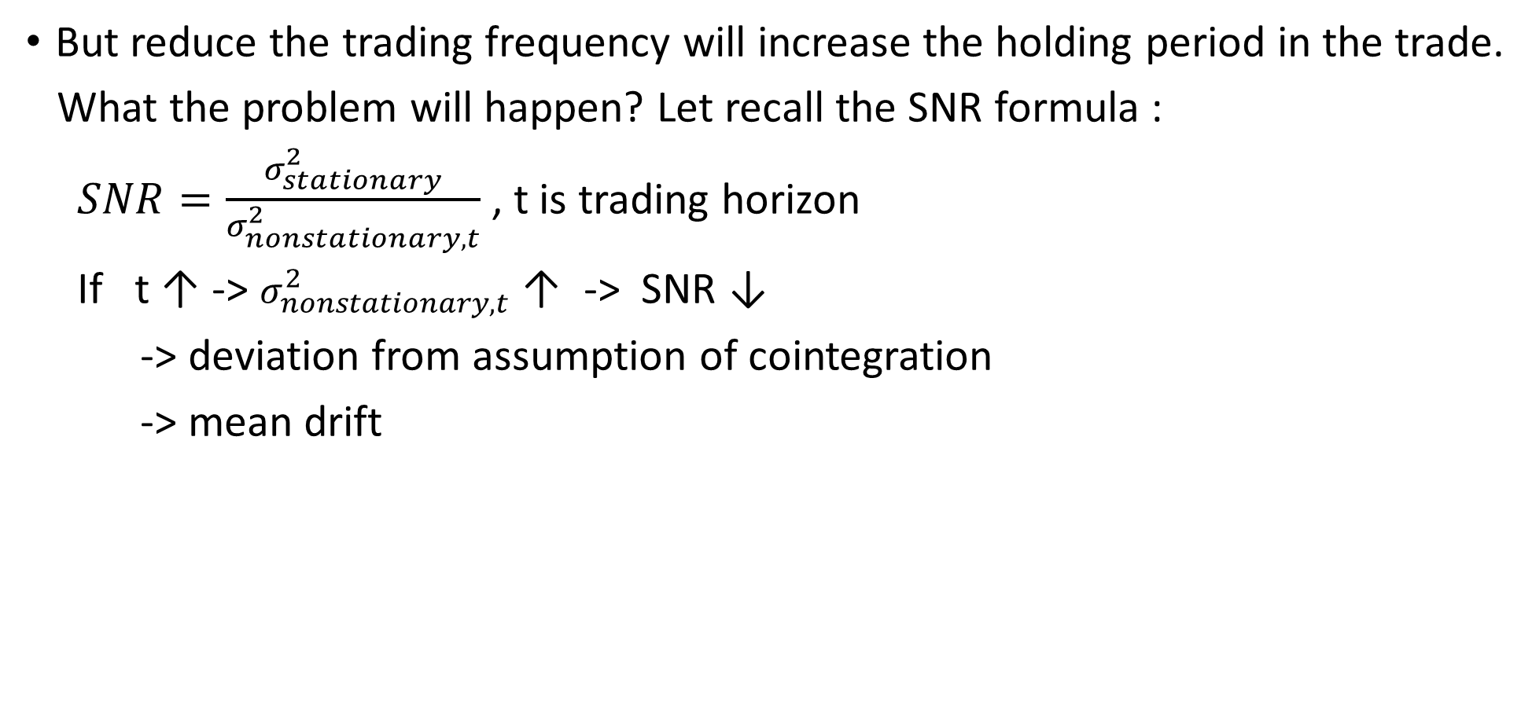
Band Design For White Noise
But reduce the trading frequency will increase the holding period in the trade.
What the problem will happen? Let recall the SNR formula :
$SNR=\frac{σ_{stationary}^{2}}{σ_{nonstationary,t}^{2}}$ , t is trading horizon
If t ↑ ->$σ_{nonstationary,t}^{2}$↑ -> SNR ↓
-> deviation from assumption of cointegration
-> mean drift

Slide 6
Band Design For White Noise
Let us to take into consideration in the trading process is the amount of inventory we are willing to hold on a spread.
we could observe the spread at regular time intervals and put on a position whenever we spot a deviation, regardless of the current holdings in inventory relying on the statistics of the spread series to control our inventory.
One spread unit:
- if we currently have one unit of spread in inventory, then even if we observe a
deviation in the same direction, we do not add on to our position.
- if the spread deviates in the opposite direction, we close out our current position
and enter into a new spread position in the opposite direction of our original
holdings.
Practical trading is probably somewhere between the two extremes.

Slide 7
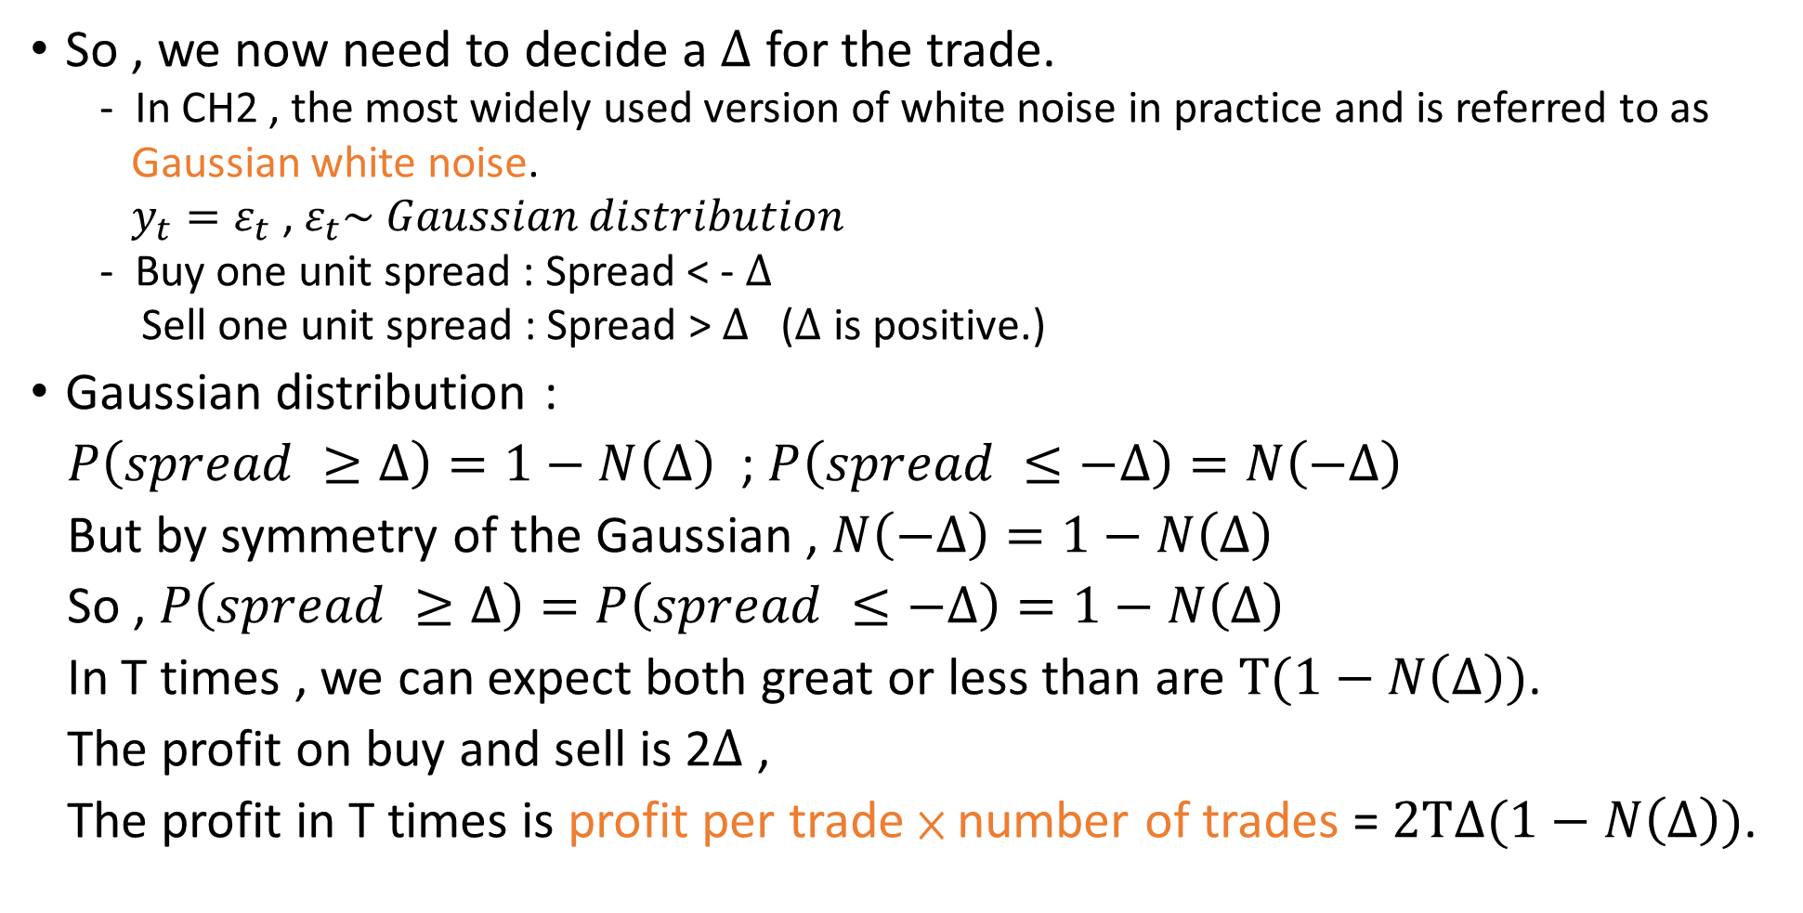
Band Design For White Noise
So , we now need to decide a $∆$ for the trade.
In CH2 , the most widely used version of white noise in practice and is referred to as
Gaussian white noise.
$y_{t}=ε_{t}$ , $ε_{t}\sim Gaussian distribution$
Buy one unit spread : Spread < - $∆$
Sell one unit spread : Spread >$∆$ ($∆$ is positive.)
Gaussian distribution :
$P\left(spread ≥∆\right)=1−N\left(∆\right)$ ; $P\left(spread ≤−∆\right)=N\left(−∆\right)$
But by symmetry of the Gaussian , $N\left(−∆\right)=1−N\left(∆\right)$
So , $P\left(spread ≥∆\right)=P\left(spread ≤−∆\right)=1−N\left(∆\right)$
In T times , we can expect both great or less than are $T(1−N\left(∆\right))$.
The profit on buy and sell is 2$∆$ ,
The profit in T times is profit per trade × number of trades = $2T∆(1−N\left(∆\right))$.

Slide 8
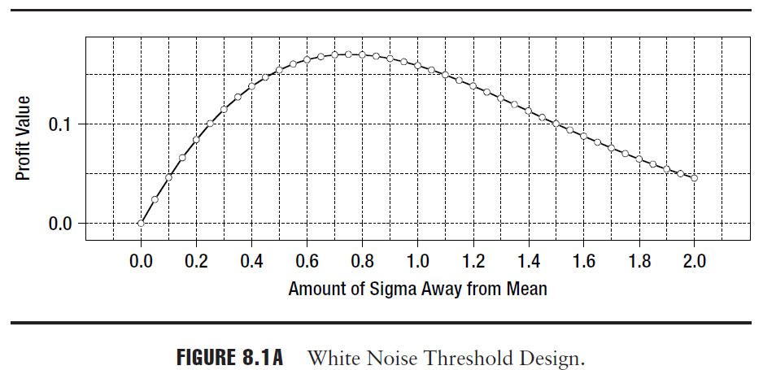

Band Design For White Noise
$2T∆(1−N\left(∆\right))$can be boils down to determining the value of Δ that maximizes $∆(1−N\left(∆\right))$.
1. x-axis is the value of Δ as measured in term
of the normal density about the mean.
2. y-axis is a plot of the function value.
3. The maximum occurs at 0.75$σ$.

Slide 9
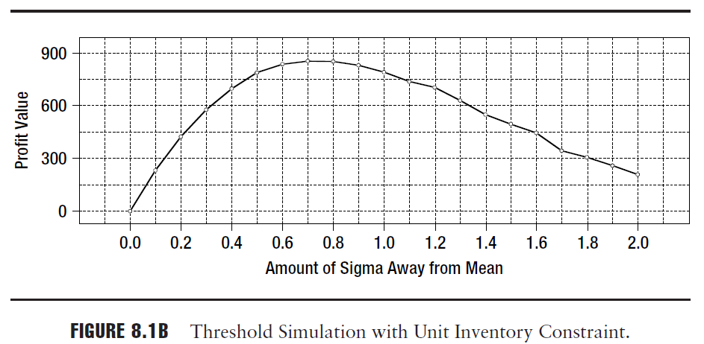
Band Design For White Noise
To check that this is true, we ran a simulation using 5,000 white noise realizations and calculated the profits for different values of Δ .
We can therefore safely conclude that the inventory constraints do not matter in the process of deciding the value of Δ.

Slide 10
Spread Dynamics
Case 1 : Mixture Gaussian Model
We can expect a white noise time series for the spread to occur when trading
security pairs that have a strict parity relationship.(S&P 500 futures against
the index)
But is it reasonable to expect the white noise to be strictly Gaussian?
The trading of securities is more brisk around the open and close.(increase volatility)
The model should become :
High Low High (volatility)
Open Midday Close (time)
This book tell us :
We should considerate the GARCH effect in the volatility of individual stock.

Slide 11
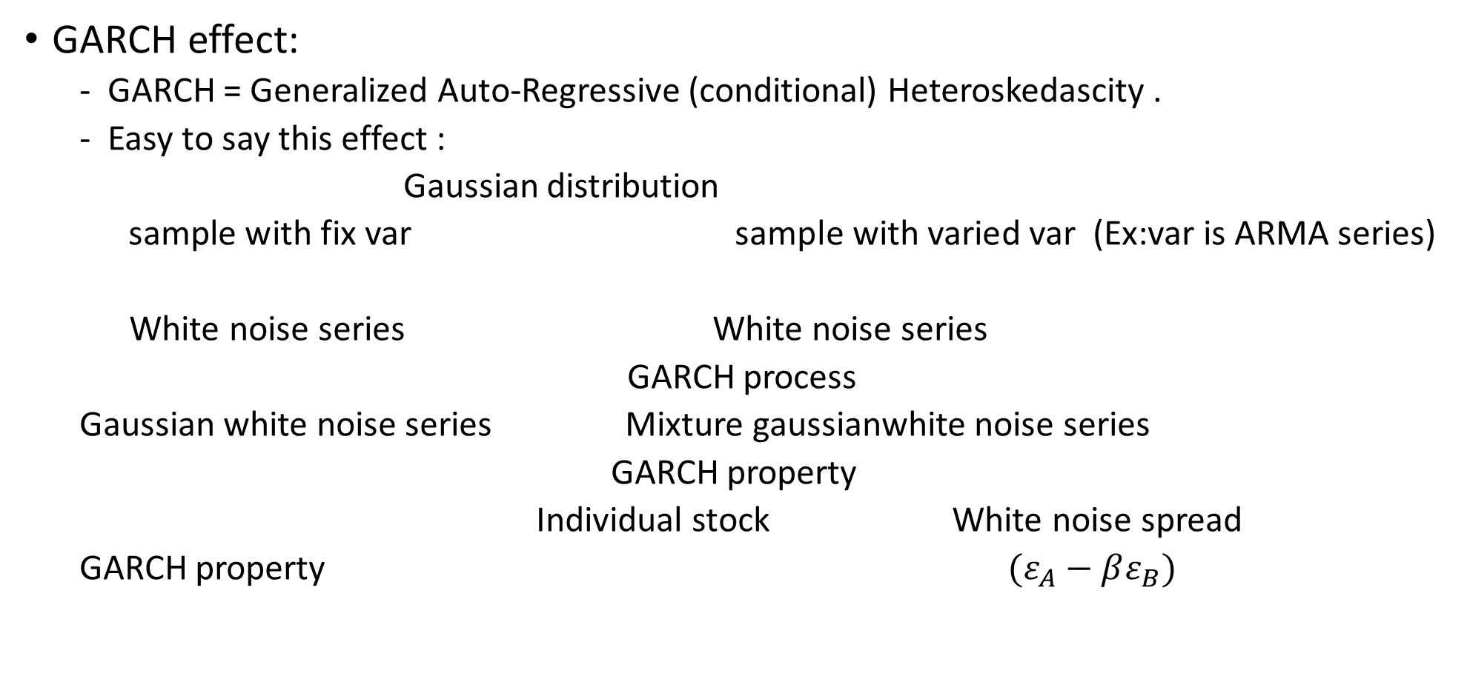
Spread Dynamics
GARCH effect:
GARCH = Generalized Auto-Regressive (conditional) Heteroskedascity .
Easy to say this effect :
Gaussian distribution
sample with fix var sample with varied var (Ex:var is ARMA series)
White noise series White noise series
GARCH process
Gaussian white noise series Mixture gaussianwhite noise series
GARCH property
Individual stock White noise spread
GARCH property $(ε_{A}−βε_{B})$

Slide 12
Spread Dynamics
How do we design the trading rule in this case?
Multiple threshold at open and close (Not one threshold value)
Estimate the component Gaussian distributions and design the levels for each one of them.
An alternate approach would be to do a dynamic estimation of the volatility using say Kalman filtering methods and let the levels vary with time.

Slide 13
Spread Dynamics
Case 2 : ARMA Model
Let us consider the case of a stock that has just experienced a news event.
High price lead to High price
events Stock
Low price lead to Low price
Momentum-like behavior
When we paired two stock but the event was specific to the particular stock,
the momentum in this particular stock price series manifest itself as
momentum in the spread series.

Slide 14
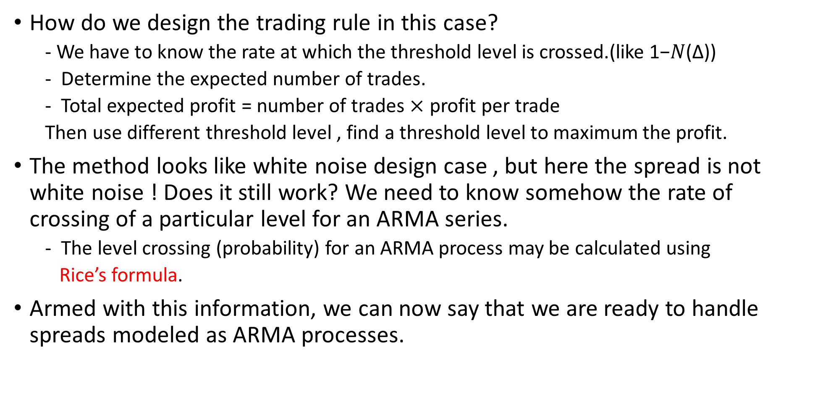
Spread Dynamics
How do we design the trading rule in this case?
- We have to know the rate at which the threshold level is crossed.(like 1−𝑁(∆))
Determine the expected number of trades.
Total expected profit = number of trades $×$ profit per trade
Then use different threshold level , find a threshold level to maximum the profit.
The method looks like white noise design case , but here the spread is not white noise ! Does it still work? We need to know somehow the rate of crossing of a particular level for an ARMA series.
The level crossing (probability) for an ARMA process may be calculated using
Rice’s formula.
Armed with this information, we can now say that we are ready to handle spreads modeled as ARMA processes.

Slide 15
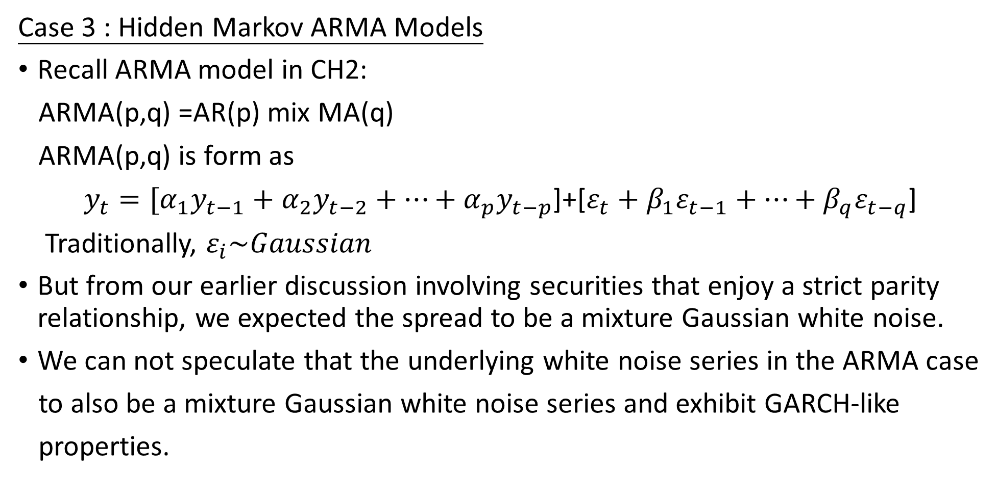
Spread Dynamics
Case 3 : Hidden Markov ARMA Models
Recall ARMA model in CH2:
ARMA(p,q) =AR(p) mix MA(q)
ARMA(p,q) is form as
$y_{t}=[α_{1}y_{t−1}+α_{2}y_{t−2}+…+α_{p}y_{t−p}$]+[$ε_{t}+β_{1}ε_{t−1}+…+β_{q}ε_{t−q}$]
Traditionally, $ε_{i}\sim Gaussian$
But from our earlier discussion involving securities that enjoy a strict parity relationship, we expected the spread to be a mixture Gaussian white noise.
We can not speculate that the underlying white noise series in the ARMA case
to also be a mixture Gaussian white noise series and exhibit GARCH-like
properties.

Slide 16
Spread Dynamics
The most generalized model to cover these cases could be to say that the
underlying white noise series is generated by drawing a sample from a
Gaussian distribution.
Better still, we say that the exact distribution to use is decided by a Markov process.
Why?
A Markov process is a process where the set of outcomes of the dice rolling is
dependent on the current distribution.
After the distribution is decided, we then use it to draw the white noise realization.
The white noise generation in this case is a two-step process.
Step 1 Decides the distribution to sample from.
Step 2 Actually draws a sample from the distribution.
Models of this kind have been used in speech processing and are termed hidden Markov models.

Slide 17
Spread Dynamics
The modeling process described in this section is actually a synthesis of the models described in the two earlier sections.
How do we decide the threshold values in this case?
There are no known methods as of now to evaluate the level-crossing rates other than by way of simulation.
One could extract the model parameters from the existing sample and generate time series data using these parameters.
The profit potential of a threshold value is then estimated by simulating trades on the generated data.
The profits thus calculated could then be used to determine the optimal value for the threshold.
We can understand how design in this case clearly next page.

Slide 18
Residual series
simulate
Characteristic of Parametric
generate
Sample
estimate
Threshold

Slide 19
Spread Dynamics
Commentary
It appears that the closer we wish to model the spread to reality, the more complicated the models get.
Find the spread dynamic Decide the threshold Profit
It is necessary to know the dynamics of spread behavior intimately and have parametric models (models where knowledge of a few parameters gives us a complete description
of the dynamics) describing their behavior.
So , we resort to nonparametric methods where we estimate the profit profile function directly from the sample realization of the spread.

Slide 20
Nonparametric Approach
One of the key issues that relate to estimating the profit function directly is
the size of the spread sample.
The larger the size of the sample the more confident we can be that the sample truly
represents all aspects of the behavior of the spread.
The statement above has in it a built-in assumption of Ergodicity.
Ergodicity hypothesis in this book:
A large sample size is effectively equivalent to having multiple realizations of the series
of smaller sample sizes.

Slide 21
Nonparametric Approach
We already know the true functional form of the profit in the white noise case and therefore the true optimal value for the threshold.
So , we will apply the approach to the white noise case.
The threshold value estimated using this approach can now be compared with the true value, thus providing us with a validation of the nonparametric approach suggested
Let us consider the situation where we calculate the observed spread using the last traded price in both the securities.
We can typically expect to buy a security on the bid price and sell the other on the
offered price.(Give up the bid-ask spread in both)
Let us consider two candidate threshold levels that are spaced very close to each
other.(the candidate threshold levels apart by at least the estimated slippage on
trading.)

Slide 22
Nonparametric Approach
Approach begin :
We begin with a simple count of the number of times the spread exceeds a particular
threshold.
When the threshold is above the mean, this is the number of times the spread is greater than the threshold . Similarly, when the threshold is below mean, it is the number of times the spread value is below the threshold.
This count for each threshold level can then be multiplied by the profit value corresponding to the threshold level to obtain the raw profit function.
The underlying spread series is a white noise sample with 75 data points.

Slide 23
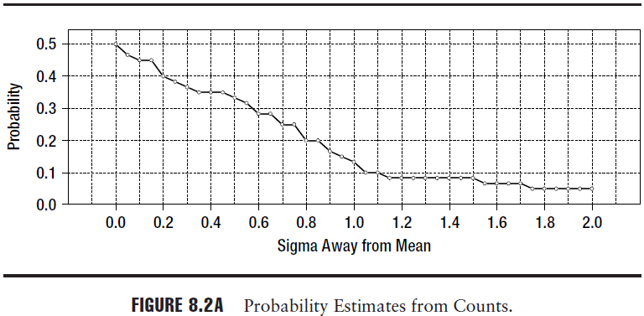
Nonparametric Approach
Figure 8.2a is the plot of the probability estimates from a simple count of the number of level crossings.

Slide 24
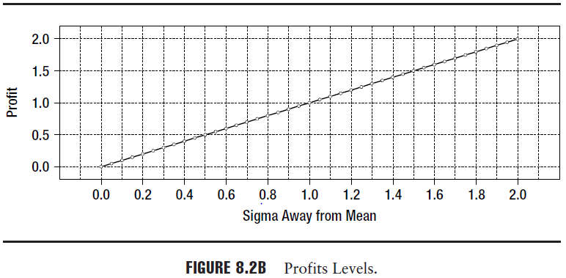
Nonparametric Approach
Figure 8.2b is the plot of the profit made for trading the spread at a particular threshold, which is equal to the threshold value itself.

Slide 25
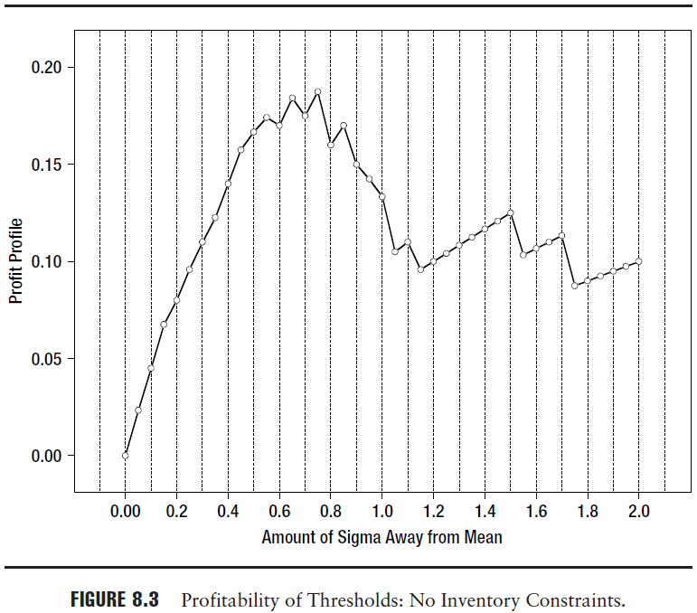
Nonparametric Approach
Figure 8.3 is a plot of the raw profit profile for the white noise sample with 75 data points

Slide 26

Nonparametric Approach

Slide 27
Nonparametric Approach
From Figure 8.3 , it could be rather confusing to arrive at any meaningful conclusion on where exactly the thresholds must be placed.(Which level make profit maximum?)
Let us now attempt to explain the reason why we obtain such a noisy estimate
for the profit profile.
Small sample size
Discrete level
We expect Figure 8.2a to be monotonically decreasing in reality.(But it seem not)
We shall term this the “discretization effect”.
To obtain a frequency count that is monotonically decreasing, we would need to correct for this discretization effect.

Slide 28
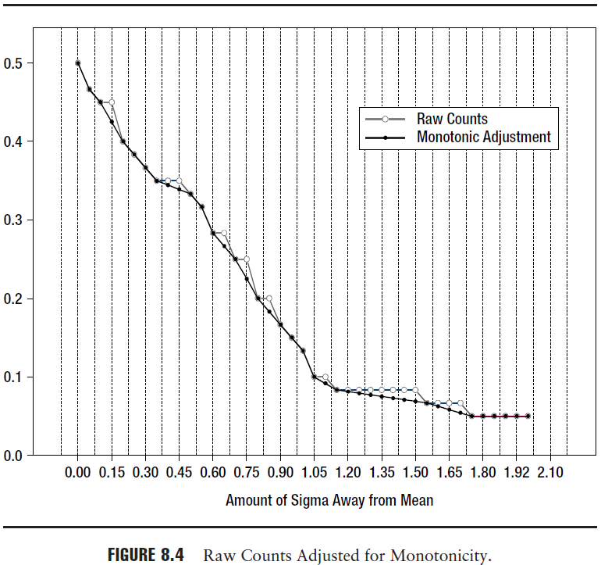
Nonparametric Approach
We can correct for the discretization
effect and ensure a monotonically
decreasing function by performing a
simple linear interpolation between
the points constituting the two levels
in the step function.
The solution we propose to
overcome this is widely
known as regularization.

Slide 29
Regularization
The fundamental idea in regularization is that of two cost measures.
The first cost measure quantifies the degree of agreement of the computed function to
the given data.
The second cost measure quantifies the deviation from a known property of the
function like.(degree of smoothness )
If we decide to fit the functional form very closely to the data, then we may have to give
some slack on the degree of smoothness of the data.
if we adhere strongly to the notion that the function is smooth, we may have to sacrifice on the agreement of the function to the data.
The choice of the function therefore involves a delicate balancing act between the two cost measures.
If the cost measure is the sum of the squared difference between adjacent points in the estimated function, then it is called Tikhonov-Miller
regularization.

Slide 30
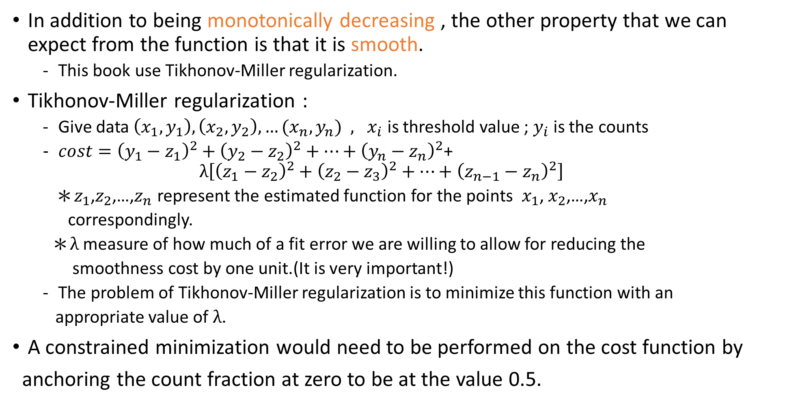
Regularization
In addition to being monotonically decreasing , the other property that we can expect from the function is that it is smooth.
This book use Tikhonov-Miller regularization.
Tikhonov-Miller regularization :
Give data $\left(x_{1},y_{1}\right),\left(x_{2},y_{2}\right),…(x_{n},y_{n}){ , x}_{i}$ is threshold value ; $y_{i}$ is the counts
$cost={\left(y_{1}−z_{1}\right)}^{2}+{\left(y_{2}−z_{2}\right)}^{2}+…+{\left(y_{n}−z_{n}\right)}^{2}$+
$$λ\left[{\left(z_{1}−z_{2}\right)}^{2}+{\left(z_{2}−z_{3}\right)}^{2}+…+{\left(z_{n−1}−z_{n}\right)}^{2}\right]$$
✽$z_{1}$,$z_{2}$,…,$z_{n}$ represent the estimated function for the points $x_{1}$, $x_{2}$,…,$x_{n}$
correspondingly.
✽$λ$ measure of how much of a fit error we are willing to allow for reducing the
smoothness cost by one unit.(It is very important!)
The problem of Tikhonov-Miller regularization is to minimize this function with an
appropriate value of $λ$.
A constrained minimization would need to be performed on the cost function by
anchoring the count fraction at zero to be at the value 0.5.

Slide 31
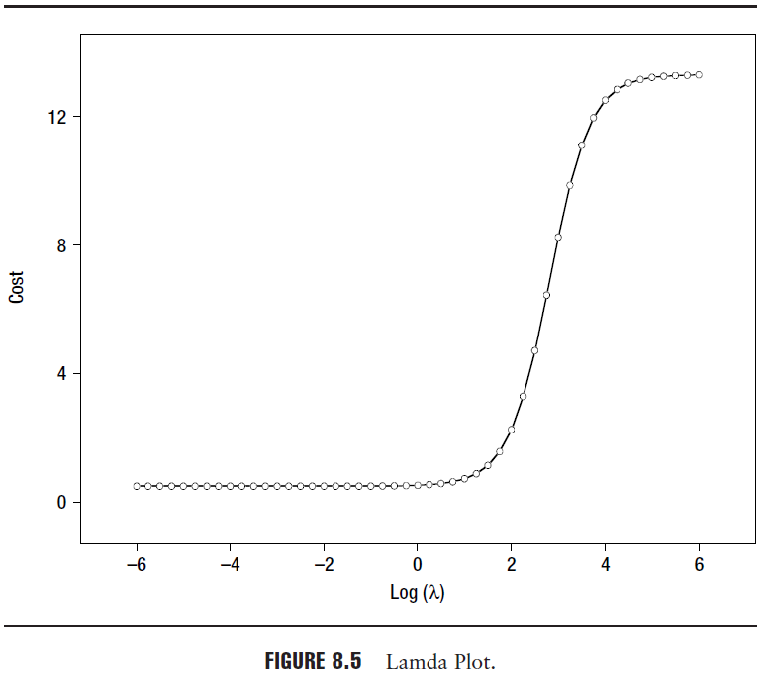

Regularization
How do we determine the correct value for $λ$ and the resulting regularized function?

Slide 32
Regularization
smoothing term dominating the cost function
fit error dominates the cost function

Slide 33
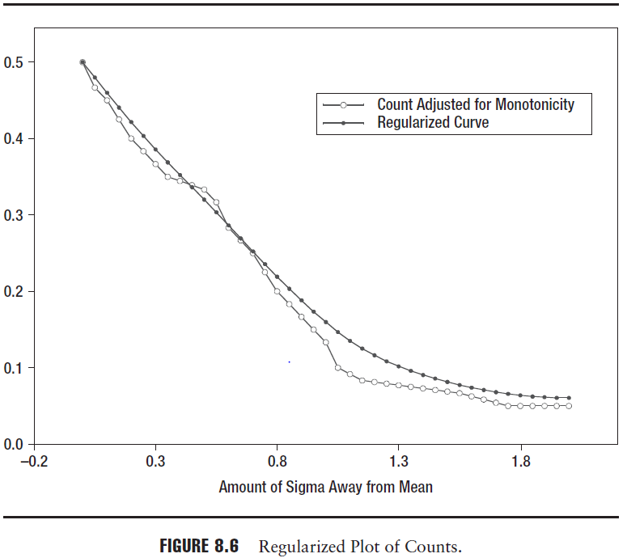
Regularization

Slide 34
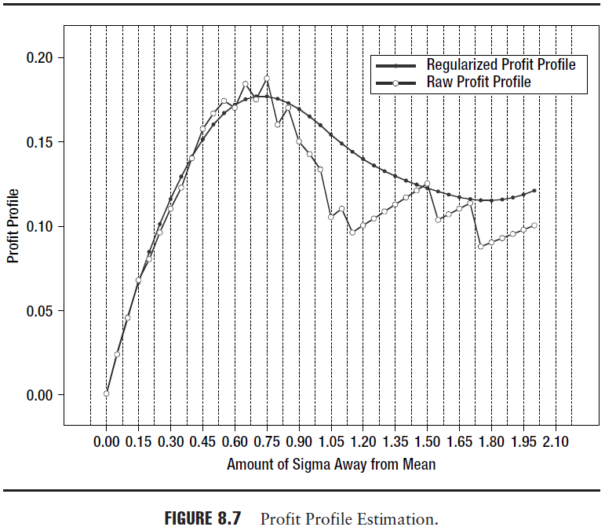
Regularization

Slide 35
Tying Up Loose End
In this section we highlight some issues of importance that were not covered
in the earlier discussions.
Multiple Thresholds Design
When the spread generated by mixture density , it will need multiple threshold.
We could do this by segmenting the time series sample based on periods or time of day.
They are checked to see if the difference between the values corresponding to the data
sets is significant.
If it is, then we have multiple thresholds. Otherwise, we stick to the single threshold approach.

Slide 36
Tying Up Loose End
Sharpe Ratio Calculations
We will desist from calculating the Sharpe ratio for a single pair because the portfolio of
pairs traded determines in a great way the eventual Sharpe ratio.
Portfolio
pair pair pair
pair pair ……
Time-Based Stops
The mere passage of time adds to the risk of holding an unconverged spread.
This is because of the residual common factor exposure resulting in the phenomenon of mean drift. With the passage of time, the SNR ratio deteriorates.
In some cases it may be worthwhile looking at unwinding at the mean value or zero spread instead of waiting for the spread to swing to the opposite direction.
Better than
Single pair

Slide 37
結束統計套利部分的問題與建議
關於報酬率相加減的問題 :
有相關文獻提到“交易比率” , 把我們用迴歸算出來的Beta在乘上一比例
通道設計 :
最後提到的非母數方法之外 , 仍有多人採用“布林格通道”
書末最後提到之止損點的建立(有相關文獻可參考)
是否超過門檻值就得馬上開倉?是否一定要等恢復均值才平倉?
買賣部位數會受掛單的數量影響,以及短線操作時必須考慮的買賣價差造成的滑價效果是否要假設不考慮?

